Slide 1

The project is prepared and presented to you by:
Eya Arfaoui
Major: Finance
Minor:IT

Slide 2

VERTEX SUPERSTORE
SALES AND PROFITABILITY ANALYSIS

Slide 3
Project Outline:
INTRODUCTION
DATA PREPARATION AND ETL PROCESS
DATA MODELING
OLAP
DATA ANALYSIS AND CONCLUSIONS
CHALLENGES AND FUTURE ENHANCEMENTS

Slide 4

INTRODUCTION:
The purpose of this project is to analyze four years (2021-2024) of sales data from Vertex superstore data warehouse to provide actionable insights for strategic decision-making. The analysis aims to support the manager in evaluating the business's performance and determining areas for improvement or expansion. Key objectives include identifying top-performing regions, customers, and products, comparing sales metrics over time, and assessing profitability to make informed investment and operational decisions.

Slide 5
This study will serve as a foundation for potential actions such as:
Opening new stores in promising regions.
Reorganizing marketing strategies to target high-performing demographics.
Planning territorial extensions into new regions.

Slide 6
DATA PREPARATION:
Source Systems:
the data was mainly collected from 2 sources:
A CSV file containing fields: Order ID, Order Date, Ship Date, Ship Mode, Customer Name, Segment, State, Country, Market, Region, Product ID, Category, Sub-Category, Product Name, Sales, Quantity, Discount, Profit, Shipping Cost, Order Priority, Year
A JSON file containg fields: Row ID, Order ID, Order Date, Ship Date, Ship Mode, Customer ID, Customer Name, Segment,City, State, Country, Postal Code, Market, Region, Product ID, Category, Sub-Category, Product Name, Sales, Quantity, Discount, Profit, Shipping Cost, Order Priority

Slide 7
The two data sources exhibited discrepancies in key attributes such as row ID, customer ID, year, postal code, and city. These differences will be addressed and harmonized during the ETL process to ensure data consistency and accuracy.

Slide 8

ETL process:
Extraction:
Data was gathered from the website Kaggle.com including historical sales record from 2021 to 2024 , customer profiles and purchase history, regional sales trends
Transformation:
The transformation process was conducted entirely using Python.
We began by adding a customer ID column to the CSV file

Slide 9
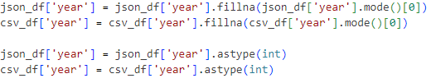
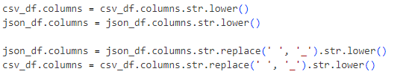
A year column to the JSON file
Next, we dropped the city, postal code, and row ID columns from the JSON file as they were not required for future analysis
The column names were unified between the two files for consistency, duplicates were removed, and null values were handled to ensure data quality. The columns were then reordered to create a standardized structure.

Slide 10
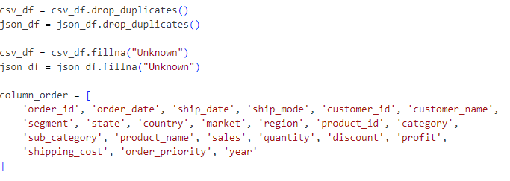

Afterward, the two files were merged into a single CSV file

Slide 11
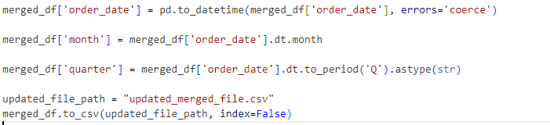
And quarter and month columns were added to the merged file to facilitate future use in the ROLAP process.
Loading:
After completing the transformation, the data was loaded into a centralized MySQL database named bi_project. To facilitate this process, the data from the merged file was split into multiple sub-files,

Slide 12
each containing the specific data required for insertion into its respective table:
sales fact, date dimension, customer dimension, or product dimension. This splitting and preparation of sub-files were handled entirely using Python to ensure efficient and accurate data loading.

Slide 13
DATA MODELING
For the data Warehouse Schema: Implemented a star schema with the following components:
Fact Table: Sales data including: sales amount, profit, quantity sold, discount, and shipping costs.
Dimension Tables: Customers, Products and Time.

Slide 14
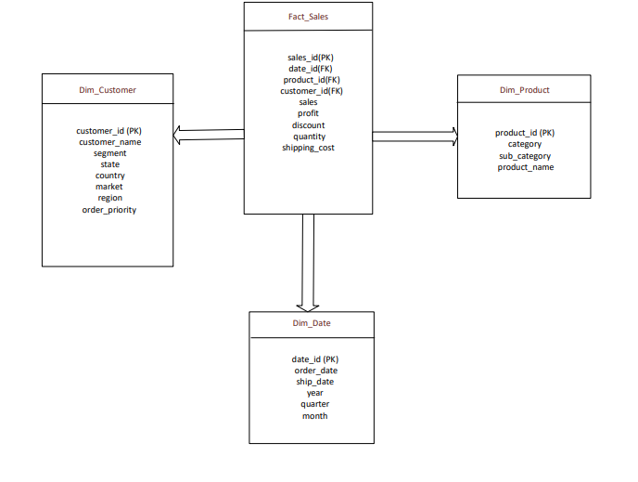

Slide 15
OLAP
Adopted ROLAP (Relational Online Analytical Processing) for efficient querying and reporting and applied the following SQL queries:
Sales Revenue: Annualy, quarterly, and monthly.
Top 10 Countries: By sales volume.
Top 10 Customers: Based on purchase frequency and revenue contribution.
Top 5 Most Profitable Products: Highest profit.
Yearly Comparisons: Highlight the most profitable year from 2021-2024
Regional Performance: Analyze profitability by region, focusing on the most profitable region in each country for 2024 to help in future investment decisions.

Slide 16
Top 5 Most Profitable Product Categories: Identify categories with the highest profit to guide strategic decisions, such as:( Increasing the supply of high-margin products, prioritizing marketing efforts for profitable categories, allocating shelf space or storage based on profitability trends).
Most Profitable Segments : To help in future marketing strategies.
Discount Analysis: Identify the effect of discount on sales.

Slide 17

DATA ANALYSIS AND CONCLUSIONS
For the data analysis, we replicated the SQL queries in Python, ensuring that the same logic and structure were applied consistently. Each query's result was exported as an output file, which was carefully prepared to serve as input for the visualization process in Power BI. This approach ensured that the data was both accurate and readily available for creating insightful dashboards and reports.

Slide 18
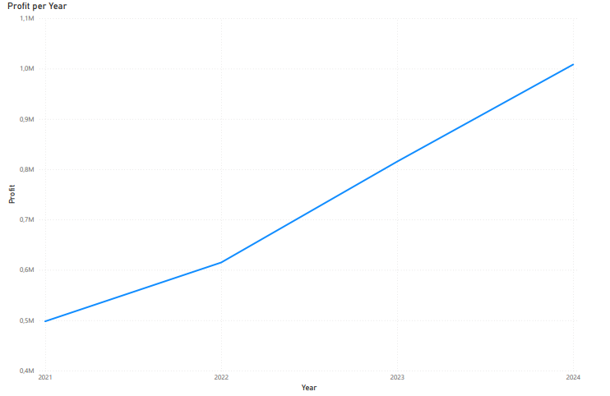
The profitability trend is increasing reaching more than 1 million dollars in 2024 which indicates a good financial position coming from operations

Slide 19
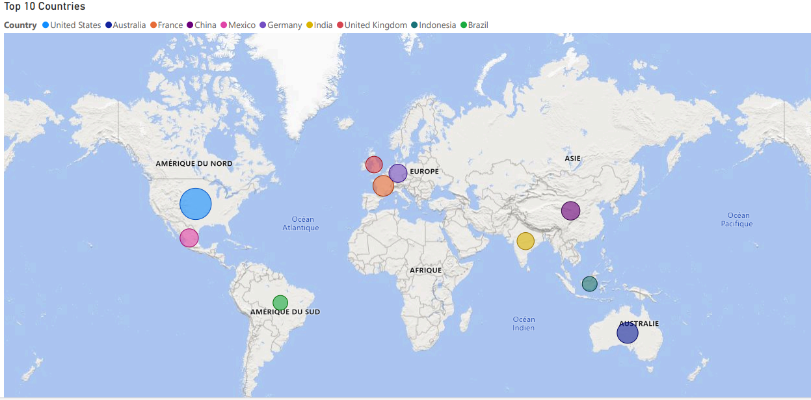

Slide 20
Most of the store’s revenue is coming from the USA, Australia and France so the company must allocate more efforts in maintaining the supply to these countries either by enhancing its shipping strategies or considering opening new stores there. Also, the firm should consider also expanding into more regions by working more on its delivery image.

Slide 21
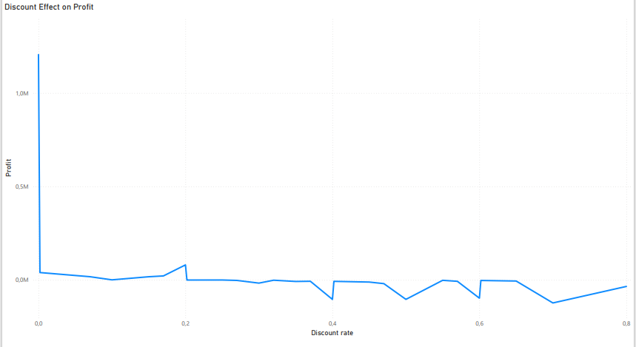
The discount effect on the store’s profits is negative: the higher the discount rate the lower the profits so the company must minimize its discount offers.

Slide 22
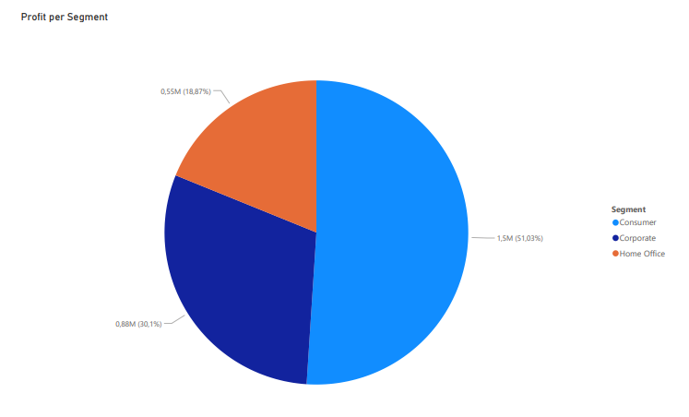
The most profitable customer segment is the Consumer representing 51.03% of the company’s total profits, so the store must allocate more marketing efforts to this segment while also try to attract more the others.

Slide 23
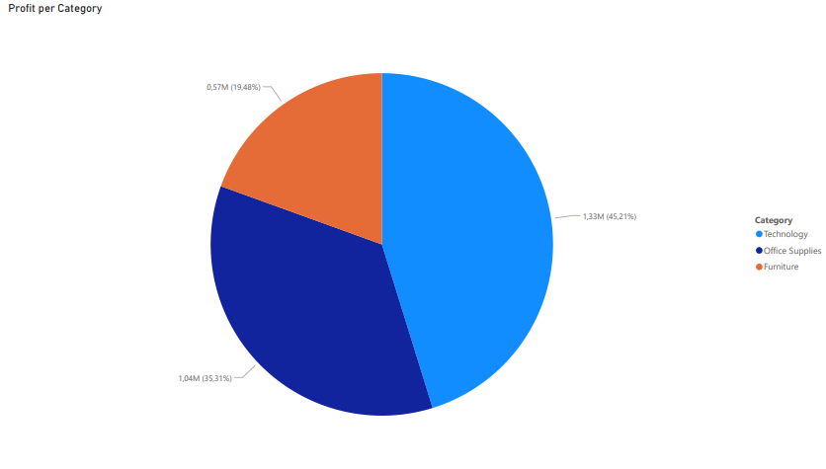
The most profitable product category is Technology contributing by 1.33 million dollars to the overall profit followed by Office Supplies then Furniture contributing respectively by 1.04 million dollars and 0.57 million dollars. As a conclusion the company should maintain high levels of supply for these categories.

Slide 24
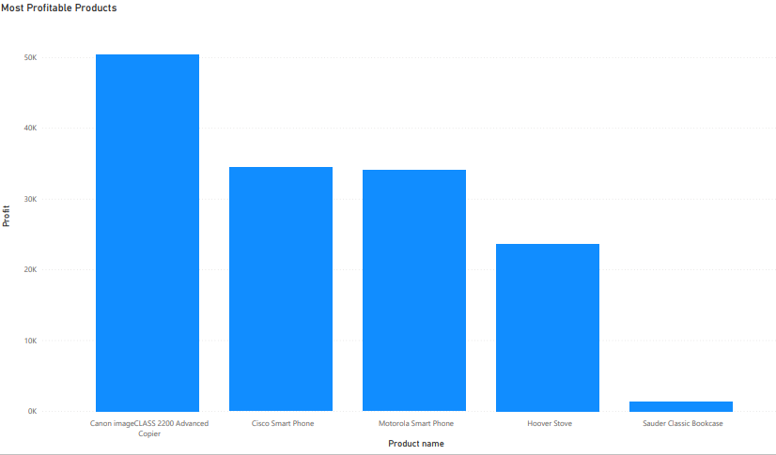
Top 4 most profitable products belong to Technology category

Slide 25
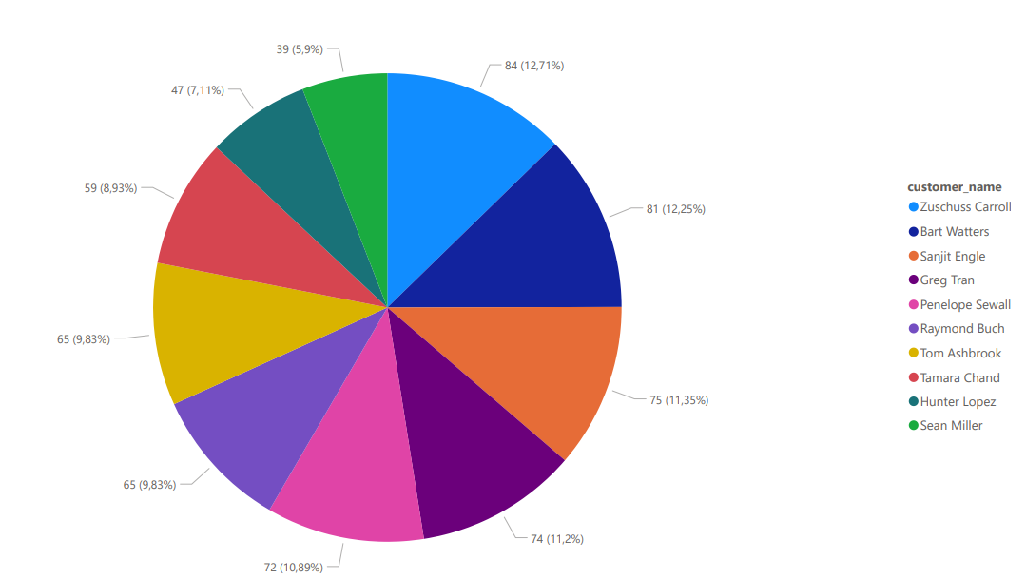
Top 10 buyers by purchasing frequency

Slide 26

CHALLENGES AND FUTURE ENHANCEMENTS
Challenges:
Handling incomplete or inconsistent data from legacy systems.
Optimizing the ETL process for large datasets.
Ensuring data accuracy and consistency across multiple sources.
Future Enhancements:
Incorporating predictive analytics for sales forecasting.
Expanding the data warehouse to include more granular data, such as marketing performance.
Developing automated alerts for key performance indicator (KPI) thresholds.

Slide 27
THANK YOU!

